Slide 1

Part 1
The Entrepreneurial Mind for an
Entrepreneurial World

Slide 2
Chapter 1
The Entrepreneurial Revolution: Changing the World Through Innovation

Slide 3
Entrepreneurial stuff
Lean and mean
50 gems
When big names backfire
When is it time to go?
StartUp Academy
Aus business ScriptRock raises $1.2 million
© McGraw-Hill Australia Pty Ltd 2011
PowerPoint slides for New Venture Creation: Entrepreneurship for the 21st Century (A Pacific Rim Focus) by Timmons et al.
1-<number>

Slide 4
What do entrepreneurs do?
© McGraw-Hill Australia Pty Ltd 2011
PowerPoint slides for New Venture Creation: Entrepreneurship for the 21st Century (A Pacific Rim Focus) by Timmons et al.
1-<number>

Slide 5
At the Heart of the Entrepreneurial Process
- Founder - Opportunity Seeker
- Creator and Initiator - Leader
- Problem Solver - Motivator
- Strategiser
- Guardian of the Venture and its mission, values,
and culture
© McGraw-Hill Australia Pty Ltd 2011
PowerPoint slides for New Venture Creation: Entrepreneurship for the 21st Century (A Pacific Rim Focus) by Timmons et al.
1-<number>

Slide 6
Innovation
Entrepreneurs change the pattern of production by combining elements in new ways. They are, in this sense, innovators.
Schumpeter
© McGraw-Hill Australia Pty Ltd 2011
PowerPoint slides for New Venture Creation: Entrepreneurship for the 21st Century (A Pacific Rim Focus) by Timmons et al.
1-<number>

Slide 7
Innovation
Small entrepreneurial firms (since WWII) are:
Responsible for half of all innovation
Credited with 95 percent of all radical innovation
Led to the creation of major new inventions and technologies
© McGraw-Hill Australia Pty Ltd 2011
PowerPoint slides for New Venture Creation: Entrepreneurship for the 21st Century (A Pacific Rim Focus) by Timmons et al.
1-<number>

Slide 8
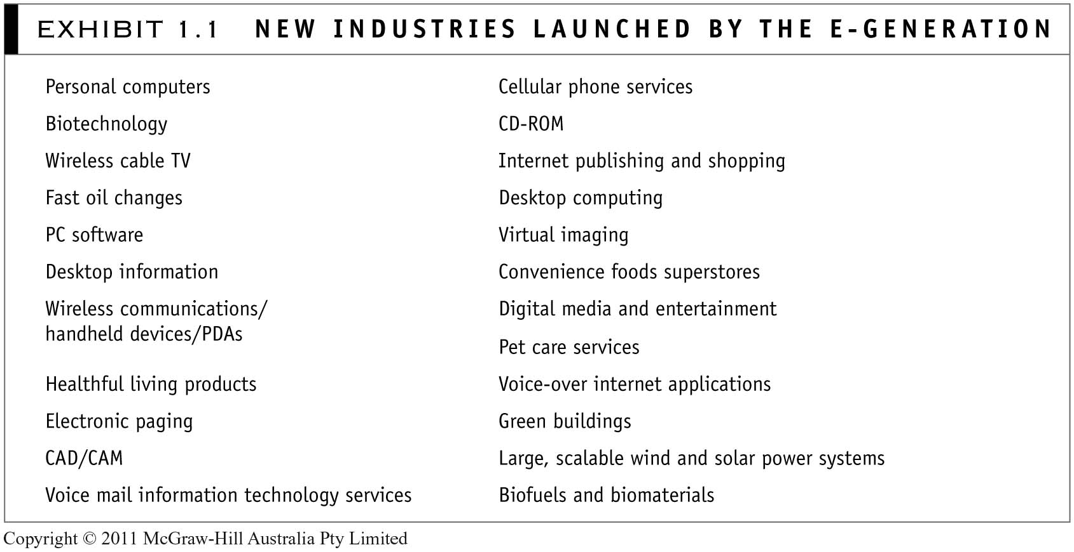
© McGraw-Hill Australia Pty Ltd 2011
PowerPoint slides for New Venture Creation: Entrepreneurship for the 21st Century (A Pacific Rim Focus) by Timmons et al.

Slide 9
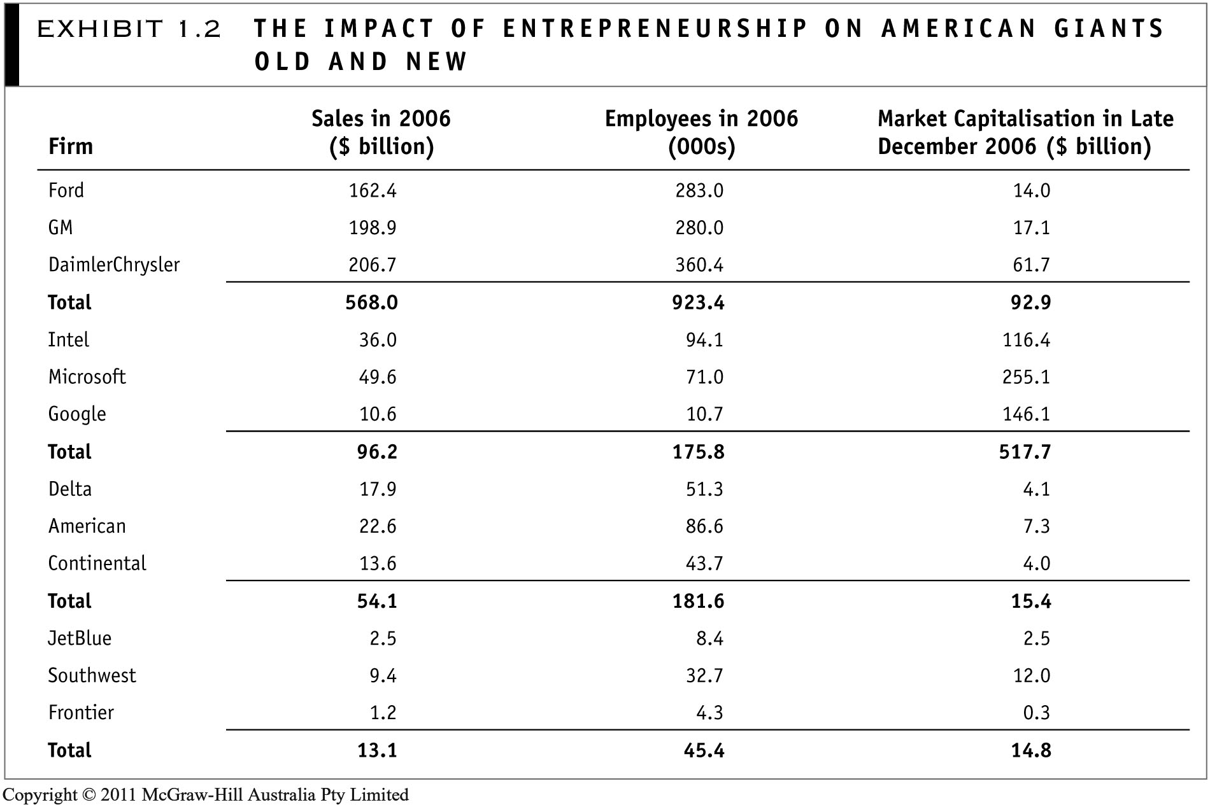
© McGraw-Hill Australia Pty Ltd 2011
PowerPoint slides for New Venture Creation: Entrepreneurship for the 21st Century (A Pacific Rim Focus) by Timmons et al.

Slide 10
New Industries Launched by the E-Generation (1 of 3)
Personal computers
Biotechnology
Wireless cable TV
Fast oil changes
PC software
Desktop information
Wireless communications/handheld devices/PDAs
© McGraw-Hill Australia Pty Ltd 2011
PowerPoint slides for New Venture Creation: Entrepreneurship for the 21st Century (A Pacific Rim Focus) by Timmons et al.
1-<number>

Slide 11
New Industries Launched by the E-Generation (2 of 3)
Healthful living products
Electronic paging
CAD/CAM
Voice mail information technology services
Cellular phone services
CD-ROM
Internet publishing and shopping
Desktop computing
Virtual imaging
© McGraw-Hill Australia Pty Ltd 2011
PowerPoint slides for New Venture Creation: Entrepreneurship for the 21st Century (A Pacific Rim Focus) by Timmons et al.
1-<number>

Slide 12
New Industries Launched by the E-Generation (3 of 3)
Convenience food superstores
Digital media and entertainment
Pet care services
Voice over Internet applications
Green buildings
Large, scalable wind and solar power systems
Biofuels and biomaterials
© McGraw-Hill Australia Pty Ltd 2011
PowerPoint slides for New Venture Creation: Entrepreneurship for the 21st Century (A Pacific Rim Focus) by Timmons et al.
1-<number>

Slide 13
Entrepreneurship Flattens the World
Significant impact on the U.S. cultural and economic landscape
Model for business, education, and policymakers around the globe
Exploding in India, China, and the former Soviet bloc
Adoption of the entrepreneurial mind-set is growing exponentially larger and faster
© McGraw-Hill Australia Pty Ltd 2011
PowerPoint slides for New Venture Creation: Entrepreneurship for the 21st Century (A Pacific Rim Focus) by Timmons et al.
1-<number>

Slide 14
Entrepreneurship Around the Globe
A 2000 EU Economic Action Plan calls for:
  Fueling entrepreneurial mind-sets
  Encouraging more people to become entrepreneurs
  Gearing entrepreneurs for growth and competitiveness
  Improving the flow of finance
  Creating a more entrepreneurial-friendly regulatory and administrative framework
© McGraw-Hill Australia Pty Ltd 2011
PowerPoint slides for New Venture Creation: Entrepreneurship for the 21st Century (A Pacific Rim Focus) by Timmons et al.
1-<number>

Slide 15
Four Entrepreneurial Transformations
That are Changing the World
Entrepreneurship is the new management paradigm for thinking and reasoning.
Entrepreneurship has spawned a new education paradigm for learning and teaching.
Entrepreneurship is becoming a dominant management model for running nonprofit businesses and social ventures.
Entrepreneurship is transcending business schools.
© McGraw-Hill Australia Pty Ltd 2011
PowerPoint slides for New Venture Creation: Entrepreneurship for the 21st Century (A Pacific Rim Focus) by Timmons et al.
1-<number>

Slide 16
Innovation + Entrepreneurship = Prosperity and Philanthropy
Entrepreneurship is an important political phenomenon.
The linkage between entrepreneurship and public policy is increasingly important.
© McGraw-Hill Australia Pty Ltd 2011
PowerPoint slides for New Venture Creation: Entrepreneurship for the 21st Century (A Pacific Rim Focus) by Timmons et al.
1-<number>

Slide 17
Job Creation
Landmark Research findings by David Birch of MIT
New firms created 81.5 percent of the net new jobs from 1969 to 1976.
According to the U.S. Small Business Administration’s Office of Advocacy, in 2004 small firm with fewer than 500 employees represented 99.9 percent of the 26.8 million businesses in the United States.
© McGraw-Hill Australia Pty Ltd 2011
PowerPoint slides for New Venture Creation: Entrepreneurship for the 21st Century (A Pacific Rim Focus) by Timmons et al.
1-<number>

Slide 18
New Venture Formation
Creates economic and social mobility
Is opportunity-centered and rewards talent and performance
Entrepreneurship is not about religion, gender, skin color, social class, or national origin
Women and a number of ethnic and racial groups are excelling at entrepreneurship
© McGraw-Hill Australia Pty Ltd 2011
PowerPoint slides for New Venture Creation: Entrepreneurship for the 21st Century (A Pacific Rim Focus) by Timmons et al.
1-<number>

Slide 19
American Dream: For the Young at Start!
Entrepreneurship is more appealing than ever to:
High school seniors
Their parents
47% of women and 38 % of men in a 2004 national sample by USA Today
Laid-off corporate managers
© McGraw-Hill Australia Pty Ltd 2011
PowerPoint slides for New Venture Creation: Entrepreneurship for the 21st Century (A Pacific Rim Focus) by Timmons et al.
1-<number>

Slide 20
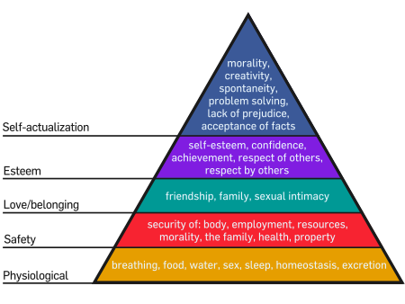
The Self-Employed Report:
The highest level of personal satisfaction
Challenge
Pride
Remuneration ($)
Love of work - it is:
  Invigorating
  Energizing
  Meaningful
© McGraw-Hill Australia Pty Ltd 2011
PowerPoint slides for New Venture Creation: Entrepreneurship for the 21st Century (A Pacific Rim Focus) by Timmons et al.
1-<number>

Slide 21
Examples of Mega-Entrepreneurs Who Started in Their 20s
Microsoft—Bill Gates and Paul Allen
Dell Computers—Michael Dell
Apple Computers—Steve Jobs and Steve Wozniak
Federal Express—Fred Smith
Polaroid—Edward Land
Nike—Phil Knight
© McGraw-Hill Australia Pty Ltd 2011
PowerPoint slides for New Venture Creation: Entrepreneurship for the 21st Century (A Pacific Rim Focus) by Timmons et al.
1-<number>

Slide 22
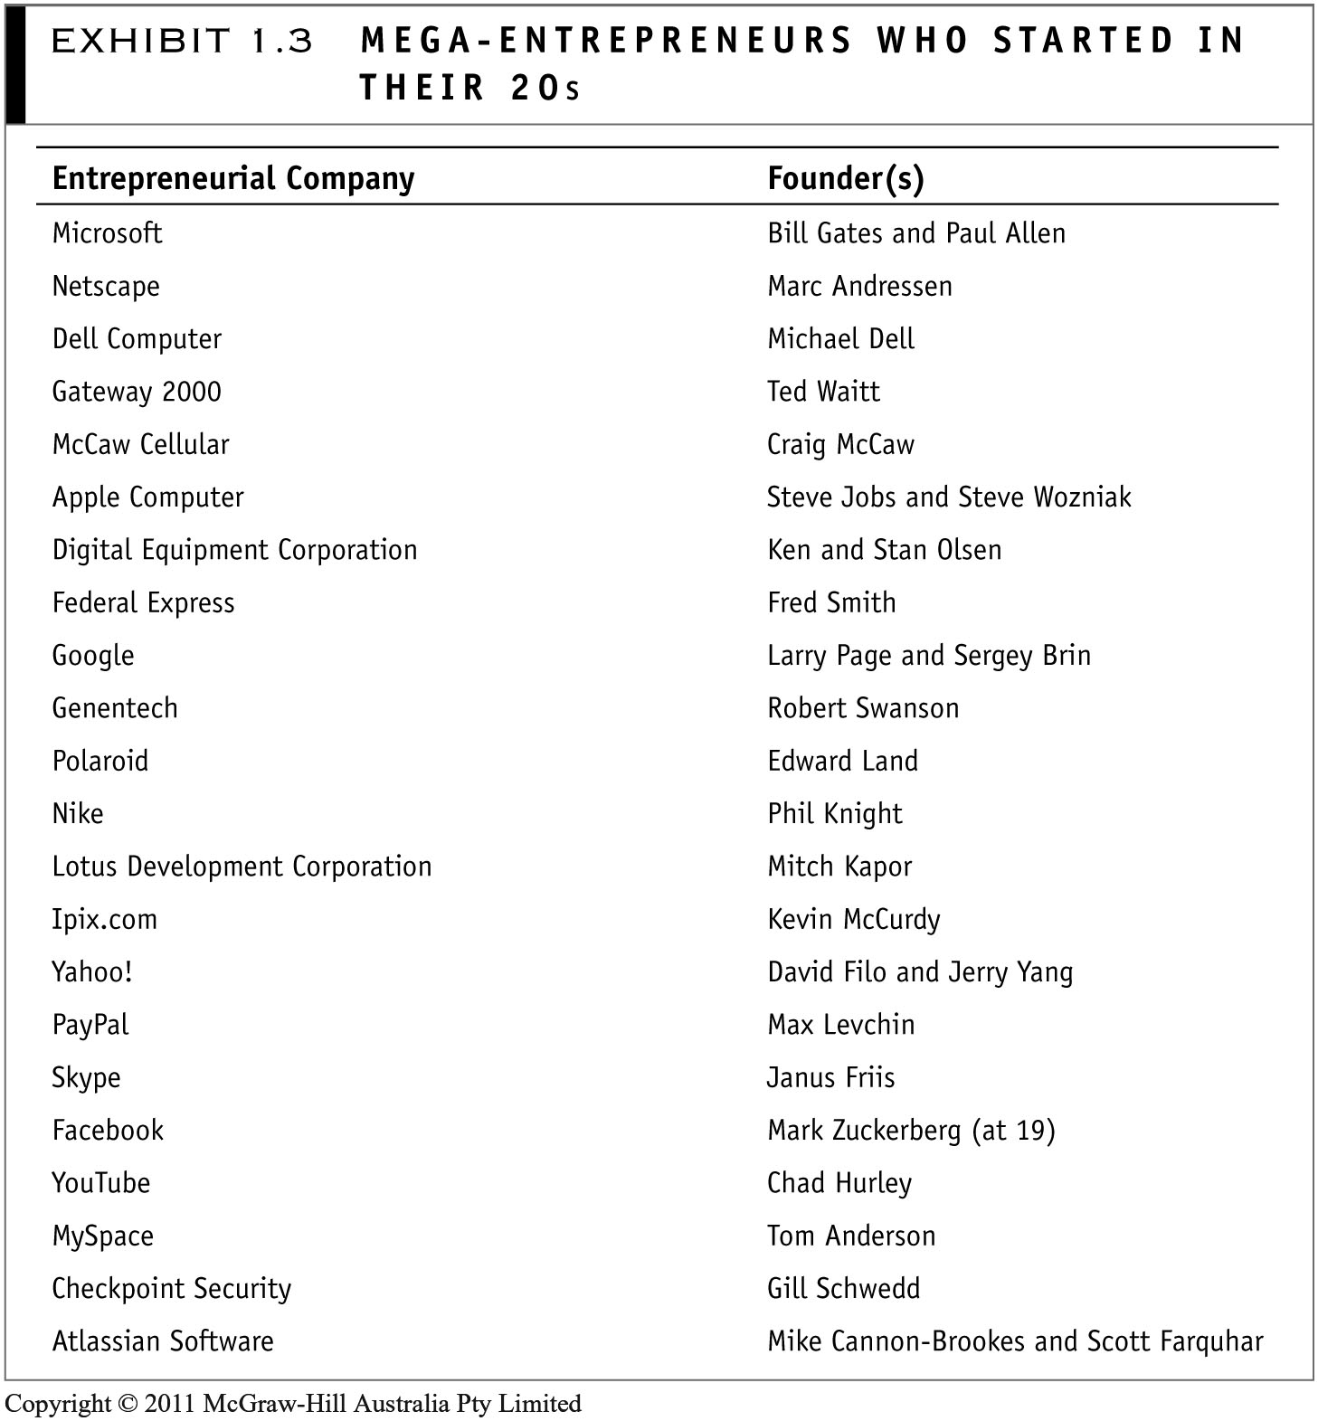
© McGraw-Hill Australia Pty Ltd 2011
PowerPoint slides for New Venture Creation: Entrepreneurship for the 21st Century (A Pacific Rim Focus) by Timmons et al.

Slide 23
Venture and Growth Capital
Classic venture capitalists:
Work as coaches and partners with entrepreneurs and innovators
At very early stages of development
To shape and accelerate the development of the company
© McGraw-Hill Australia Pty Ltd 2011
PowerPoint slides for New Venture Creation: Entrepreneurship for the 21st Century (A Pacific Rim Focus) by Timmons et al.
1-<number>

Slide 24
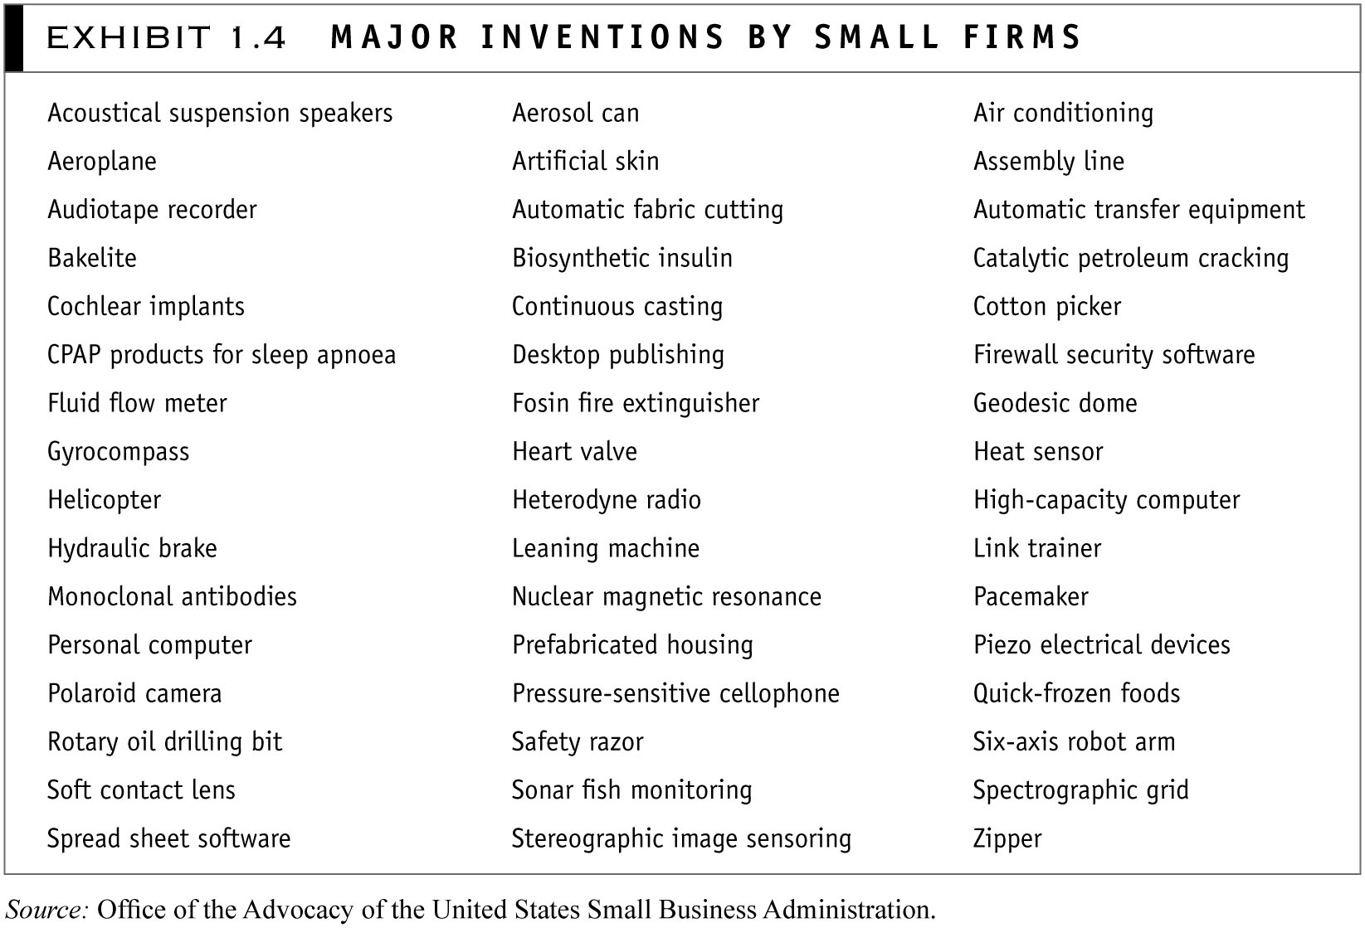
© McGraw-Hill Australia Pty Ltd 2011
PowerPoint slides for New Venture Creation: Entrepreneurship for the 21st Century (A Pacific Rim Focus) by Timmons et al.

Slide 25
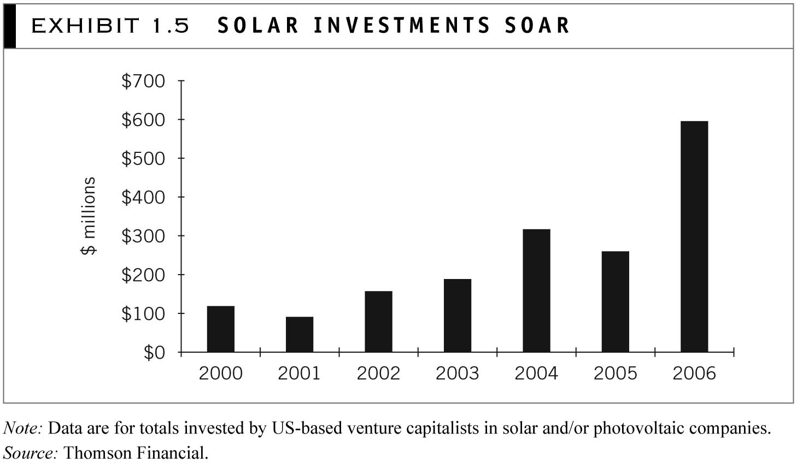
© McGraw-Hill Australia Pty Ltd 2011
PowerPoint slides for New Venture Creation: Entrepreneurship for the 21st Century (A Pacific Rim Focus) by Timmons et al.

Slide 26
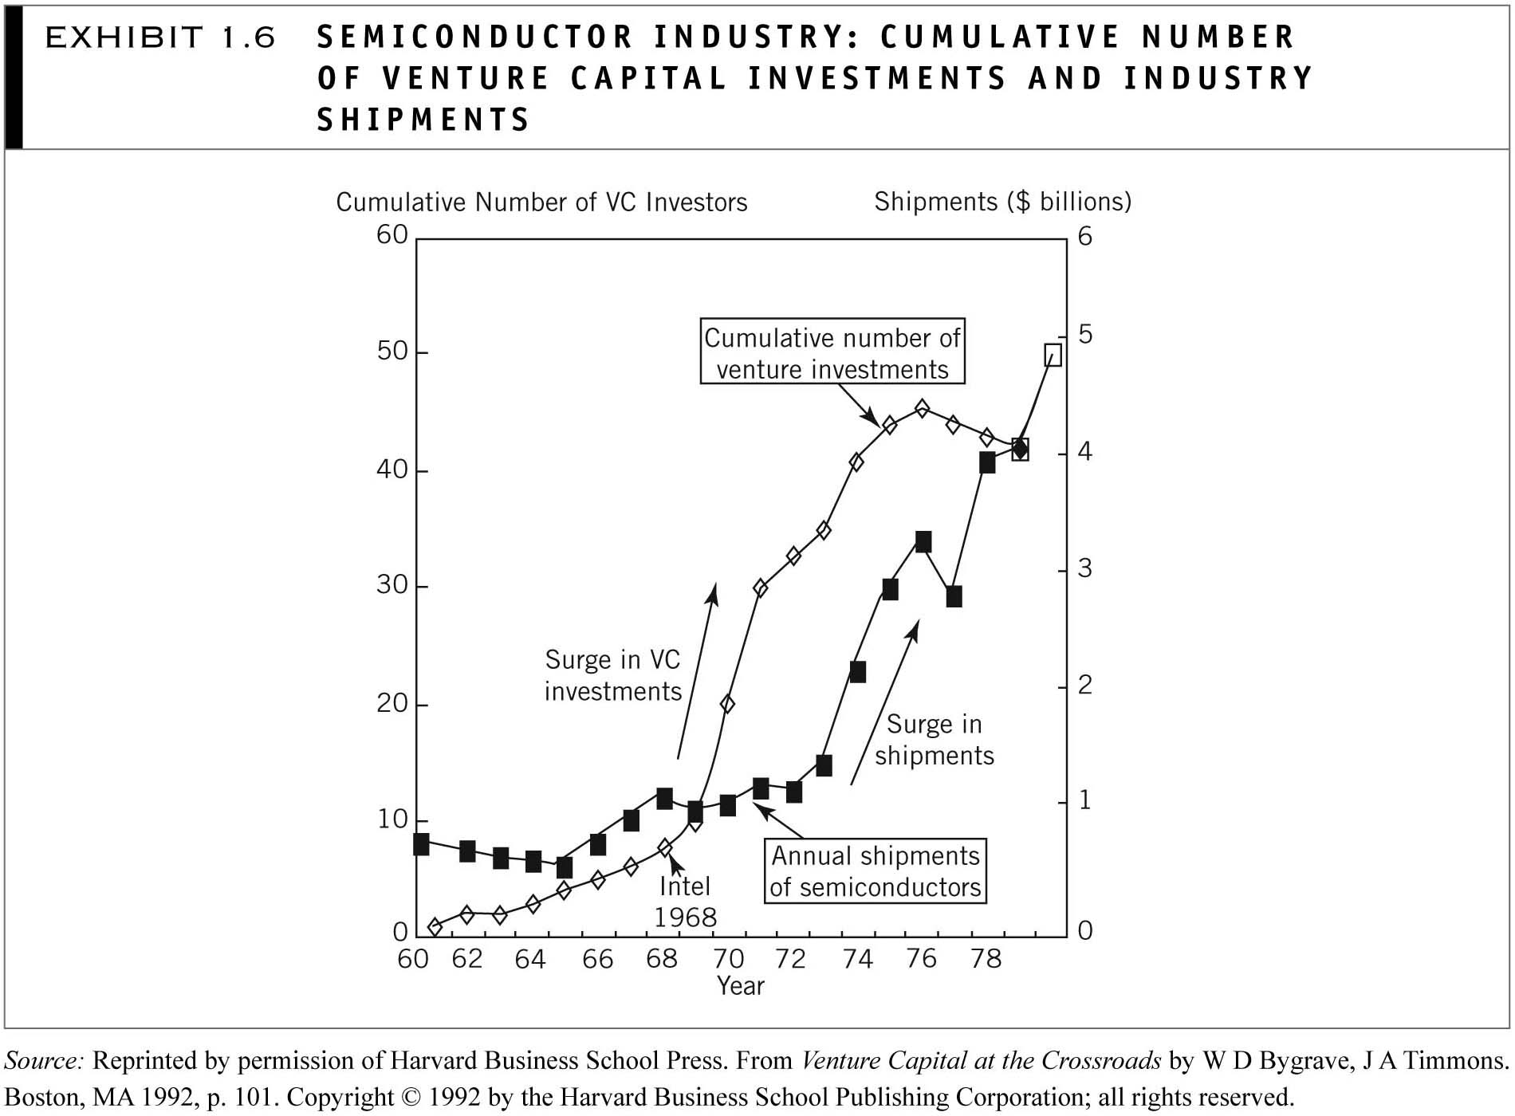
© McGraw-Hill Australia Pty Ltd 2011
PowerPoint slides for New Venture Creation: Entrepreneurship for the 21st Century (A Pacific Rim Focus) by Timmons et al.

Slide 27
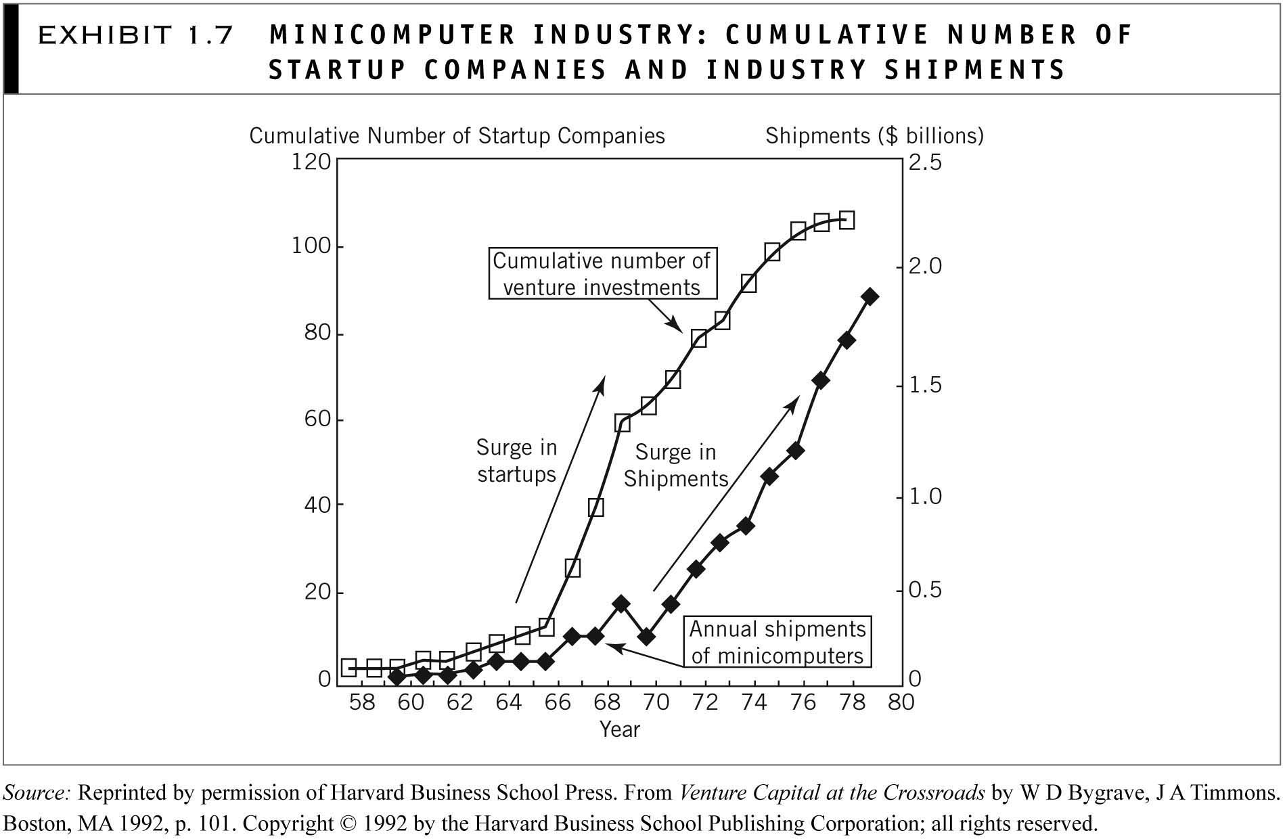
© McGraw-Hill Australia Pty Ltd 2011
PowerPoint slides for New Venture Creation: Entrepreneurship for the 21st Century (A Pacific Rim Focus) by Timmons et al.

Slide 28
Angel Investors
Moderately wealthy to very wealthy individuals
Successful entrepreneurs
  Bring experience, learning curves, networks, wisdom and maturity
  Serve as coach, confidant, mentor and cheerleader
© McGraw-Hill Australia Pty Ltd 2011
PowerPoint slides for New Venture Creation: Entrepreneurship for the 21st Century (A Pacific Rim Focus) by Timmons et al.
1-<number>

Slide 29




Aus Angel Investors
Find Angel Investors.com.au
© McGraw-Hill Australia Pty Ltd 2011
PowerPoint slides for New Venture Creation: Entrepreneurship for the 21st Century (A Pacific Rim Focus) by Timmons et al.
1-<number>

Slide 30
Philanthropy and Leadership
Successful entrepreneurs give back to the community
Colleges and universities
  New buildings, classrooms, athletic facilities, and endowed professorships
  The largest gifts and the greatest proportion of donors to college capital campaigns
Local churches, hospitals, museums, orchestras, and schools
© McGraw-Hill Australia Pty Ltd 2011
PowerPoint slides for New Venture Creation: Entrepreneurship for the 21st Century (A Pacific Rim Focus) by Timmons et al.
1-<number>

Slide 31
Ewing Marion Kauffman of Marion Laboratories, Inc.:
“Live what you talk, make your actions match your words. You must live what you preach and do it right and do it often. Day after day.”
“As an entrepreneur, you really need to develop a code of ethics, a code of relationships with your people, because it’s the people who come and join you. They have dreams of their own. You have your dream of the company. They must mesh somewhat.”
© McGraw-Hill Australia Pty Ltd 2011
PowerPoint slides for New Venture Creation: Entrepreneurship for the 21st Century (A Pacific Rim Focus) by Timmons et al.
1-<number>

Slide 32
Building an Entrepreneurial Society
The poor get richer
Equal opportunities (not equal incomes) are created
Economic mobility increases
Social mobility increases
© McGraw-Hill Australia Pty Ltd 2011
PowerPoint slides for New Venture Creation: Entrepreneurship for the 21st Century (A Pacific Rim Focus) by Timmons et al.
1-<number>

Slide 33
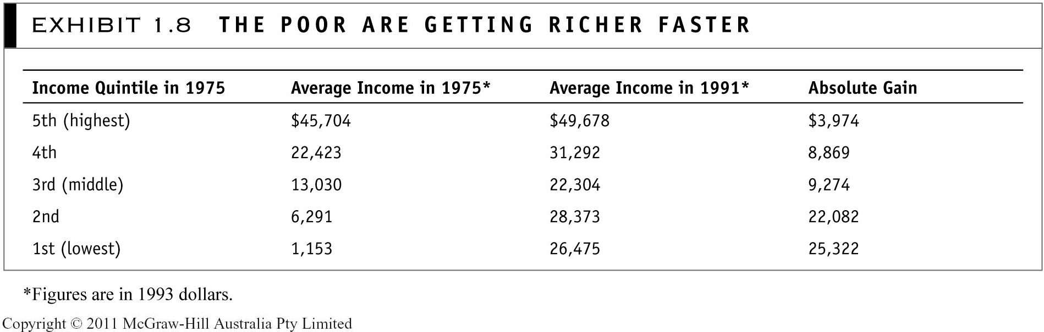

© McGraw-Hill Australia Pty Ltd 2011
PowerPoint slides for New Venture Creation: Entrepreneurship for the 21st Century (A Pacific Rim Focus) by Timmons et al.
© McGraw-Hill Australia Pty Ltd 2011
PowerPoint slides for New Venture Creation: Entrepreneurship for the 21st Century (A Pacific Rim Focus) by Timmons et al.
2-<number>

Slide 34
Mind stretchers
Most people seem to prefer predictability to unpredictability. Yet the entrepreneurial process is inherently chaotic, unpredictable and unplannable. What skills and mindsets are required?
Which countries offer the greatest entrepreneurial opportunities in the next decade? What do you need to do about this?
© McGraw-Hill Australia Pty Ltd 2011
PowerPoint slides for New Venture Creation: Entrepreneurship for the 21st Century (A Pacific Rim Focus) by Timmons et al.
1-<number>

